Slide 1
TCP/IP Protocol Suite: Transport Layer
Faculty: Dr. Asif Uddin Khan
Assistant Professor
KIIT University

Slide 2
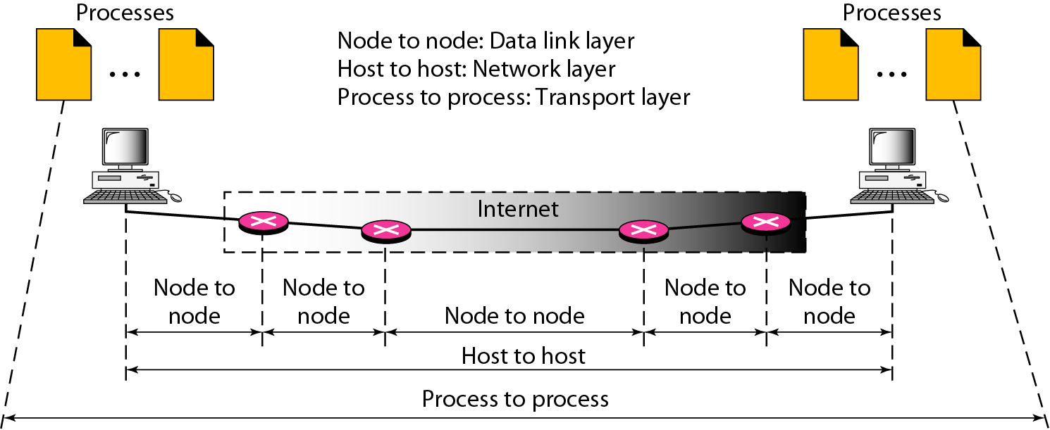
Transport layer
The transport layer is responsible for end-to-end communication between devices.
The transport layer is responsible for process-to-process delivery.
It ensures that data is transferred reliably and efficiently from one application to another.

Slide 3
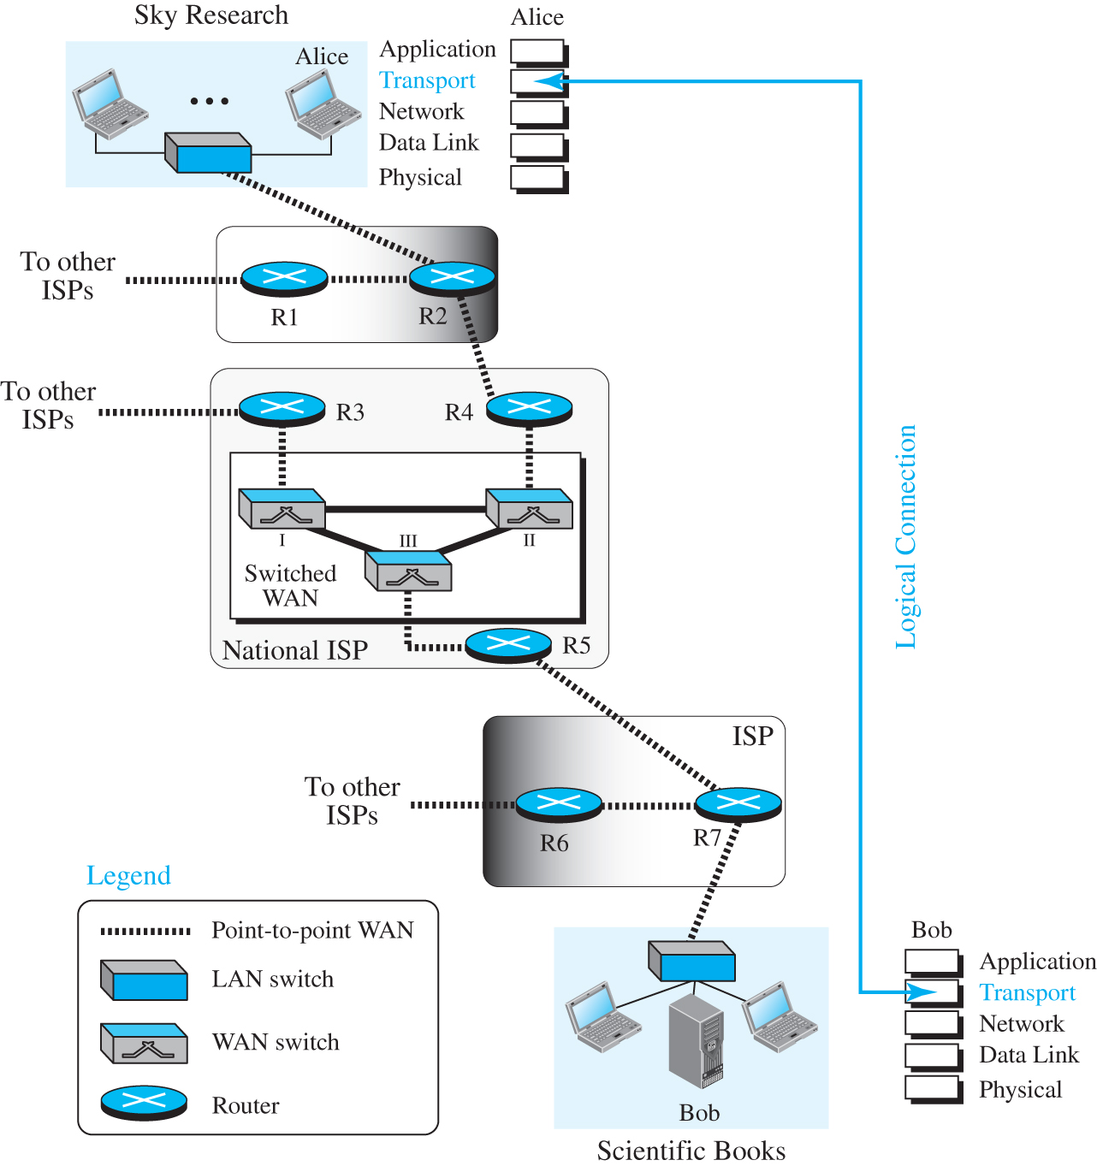
TRANSPORT LAYER SERVICES
The transport layer is located between the application layer and the network layer.
It provides a process-to-process communication between two application layers, one at the local host and the other at the remote host.
Communication is provided using a logical connection.
Figure 9.1 shows the idea behind this logical connection.
Figure 9.1 Logical connection at the transport layer

Slide 4
Functions of Transport layer
Segmentation and Reassembly: The transport layer breaks down large data messages from the application layer into smaller segments for transmission and then reassembles them at the destination.
Error Detection and Correction: It ensures that data is transmitted accurately by detecting and correcting errors that might occur during transmission.
Flow Control: The transport layer manages the rate of data transmission between sender and receiver to prevent the receiver from being overwhelmed.
Connection Establishment and Termination: For connection-oriented protocols, it sets up and terminates connections between applications.
Data Integrity: It ensures that data is delivered correctly and in the correct order.
Multiplexing: It allows multiple applications on the same device to use the network simultaneously by multiplexing multiple data streams over a single connection.

Slide 5
Key Protocols of Transport Layer
Transmission Control Protocol (TCP):
Connection-Oriented: Establishes a connection before data is sent and ensures reliable delivery.
Reliable: Provides mechanisms for error detection, correction, and retransmission of lost data.
Flow Control: Uses windowing to control the rate of data transmission.
User Datagram Protocol (UDP):
Connectionless: Does not establish a connection before sending data.
Unreliable: Provides no guarantees about delivery, ordering, or error recovery.
Low Overhead: Faster than TCP because it has less overhead, making it suitable for applications where speed is crucial, such as streaming or online gaming.

Slide 6
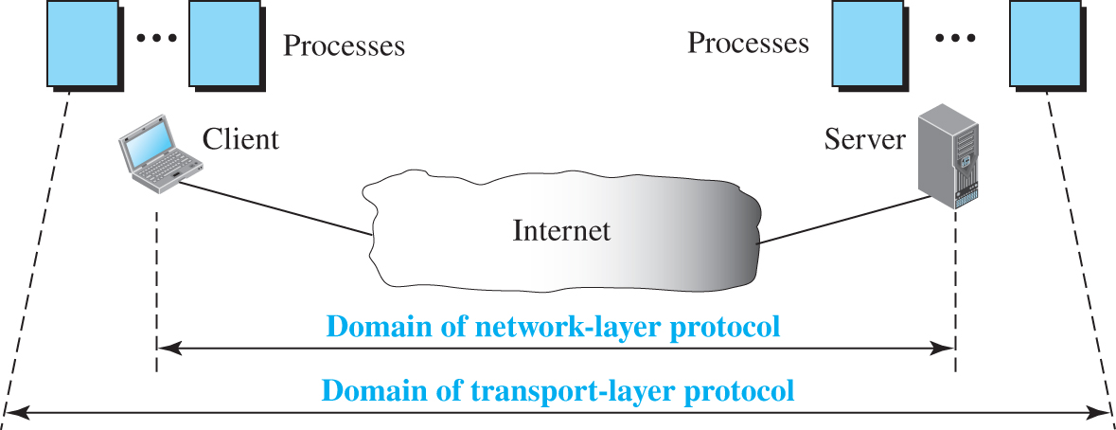
9.1.1 Process-to-Process Communication
The first duty of a transport-layer protocol is to provide process-to-process communication.
A process is an application-layer entity (running program) that uses the services of the transport layer.
Figure 9.2 show how process-to-process communication and show the difference between host-to-host communication and process-to-process communication.
Figure 9.2 Network layer versus transport layer

Slide 7
9.1.2 Addressing: Port Numbers
Although there are a few ways to achieve process-to-process communication, the most common is through the client-server paradigm.
A process on the local host, called a client, needs services from a process usually on the remote host, called a server.
However, operating systems today support both multiuser and multiprogramming environments.
A remote computer can run several programs at the same time, just as several local computers can run one or more client programs at the same time.

Slide 8
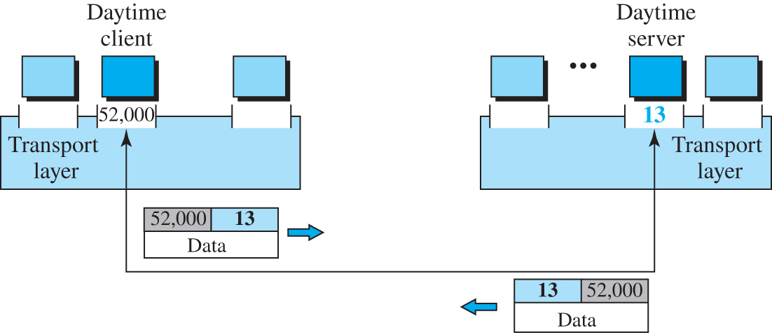
Figure 9.3 Port numbers
Port numbers are 16-bit numbers that range from 0 to 65535.
Used by transport layer protocols like TCP and UDP to distinguish between different services or applications running on a device.
Example: A transport layer represents daytime client with a layer with label 52000 and a transport layer represents daytime server with a layer label 13. Reversible communication of client and server represents 52000 13 data right arrow and 52000 13 left arrow
Access the text alternative for slide images.

Slide 9
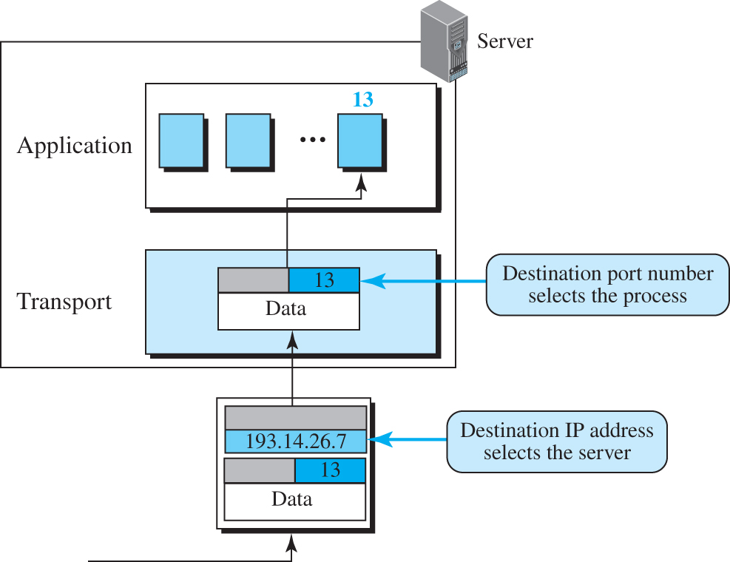
Figure 9.4 IP addresses versus port numbers
Access the text alternative for slide images.

Slide 10
ICANN Ranges
ICANN (Internet Corporation for Assigned Names and Numbers) has divided the port numbers into three ranges:
well-known port numbers (0-1023)
Registered port numbers (1024-49151)
Dynamic (or private) port numbers (49152-65535)

Slide 11
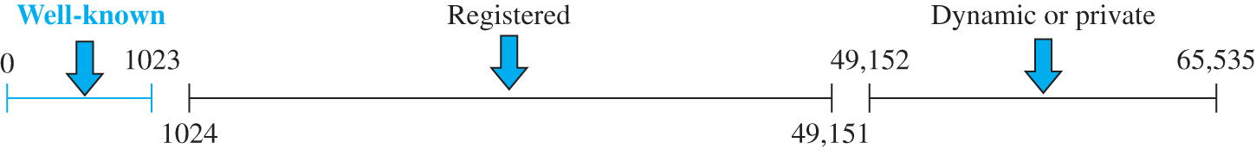
Figure 9.5 ICANN ranges
Well-Known Ports (0-1023):
These ports are reserved for widely used services and applications managed Internet Assigned Numbers Authority (IANA).
Example:
HTTP: Port 80
HTTPS: Port 443
FTP: Port 21
SMTP: Port 25
Registered Ports (1024-49151):
Used by applications and services not managed by the Internet Assigned Numbers Authority (IANA).
Example:
MySQL: Port 3306
PostgreSQL: Port 5432
Dynamic or Private Ports (49152-65535):
These ports are used for temporary connections and are typically assigned dynamically by the operating system when an application starts.
Access the text alternative for slide images.

Slide 12
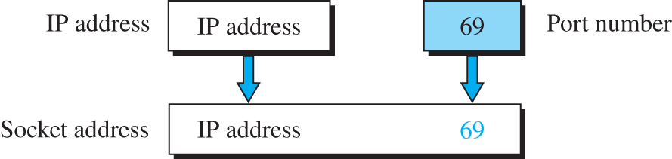
Socket address
Figure 9.6
A socket address is a combination of an IP address and a port number.
It uniquely identifies a network connection endpoint on a device.
It's used to establish communication between applications over a network

Slide 13
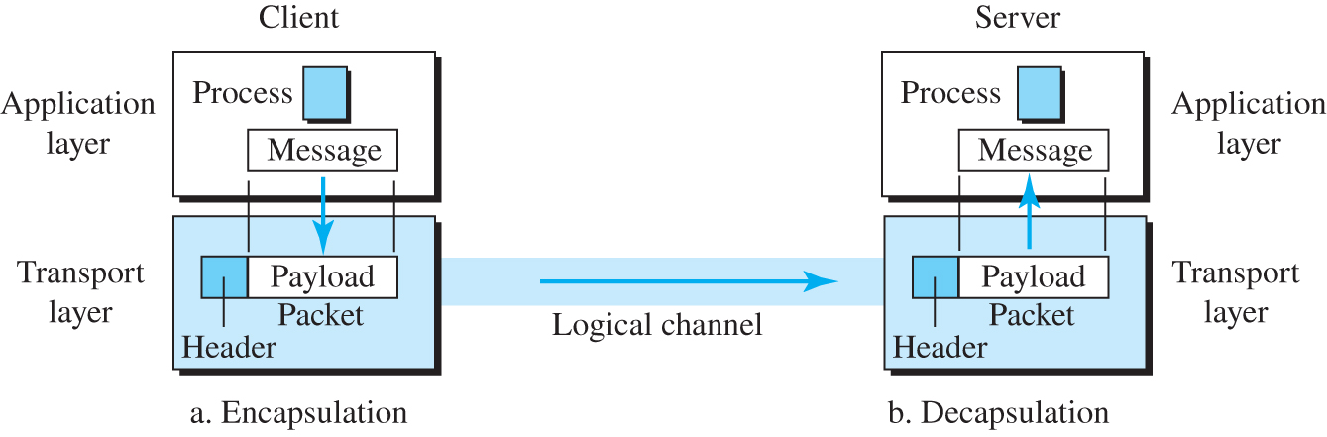
Encapsulation and decapsulation
Encapsulation involves packaging data with transport layer headers(port number and other information related to error control, flow control and congestion control).
To send a message from one process to another, the transport-layer protocol encapsulates and decapsulates messages.
Encapsulation happens at the sender site and decapsulation at receiver site.
Figure 9.7 Encapsulation and decapsulation
Access the text alternative for slide images.

Slide 14
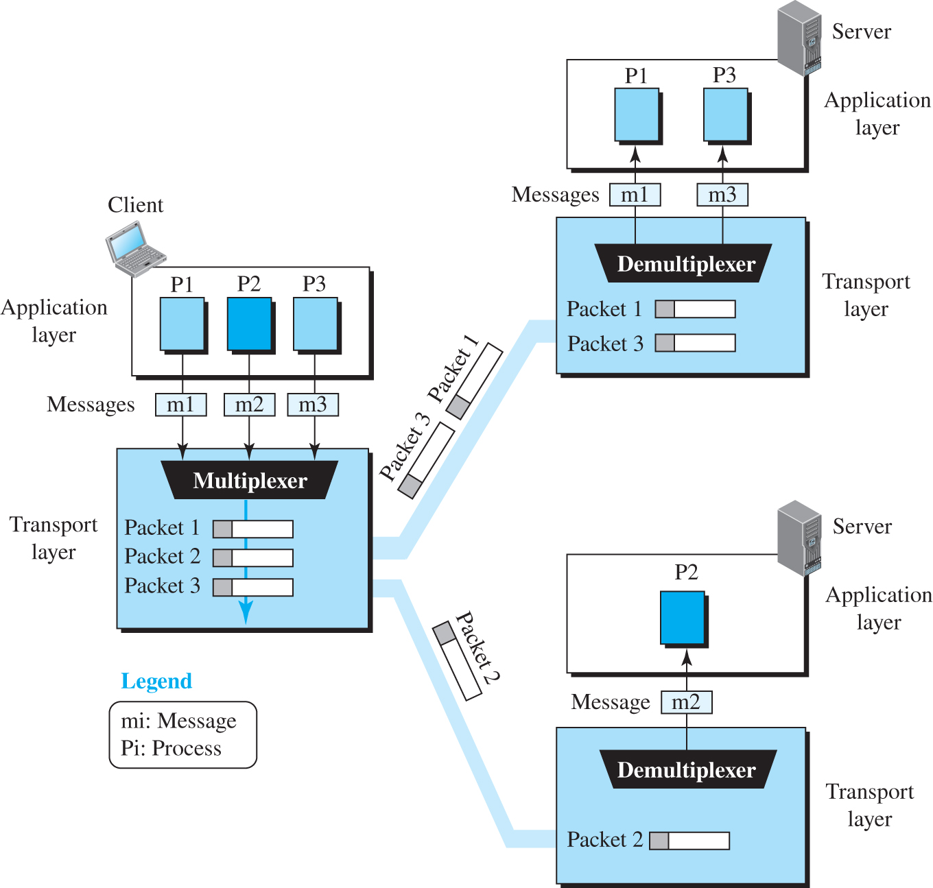
9.1.4 Multiplexing and Demultiplexing
Accepting items from more than one application or process is referred to as multiplexing (many to one);
Delivering items to more than one application or process is referred to as demultiplexing (one to many).
The transport layer at the source performs multiplexing
The transport layer at the destination performs demultiplexing.
Figure 9.8 Multiplexing and demultiplexing

Slide 15
9.1.5 Flow Control
The transport layer manages the rate of data transmission between sender and receiver to prevent the receiver from being overwhelmed with more data than it can handle, preventing potential data loss and ensuring efficient communication.
If the items are produced faster than they can be consumed, the consumer can be overwhelmed and may need to discard some items.

Slide 16
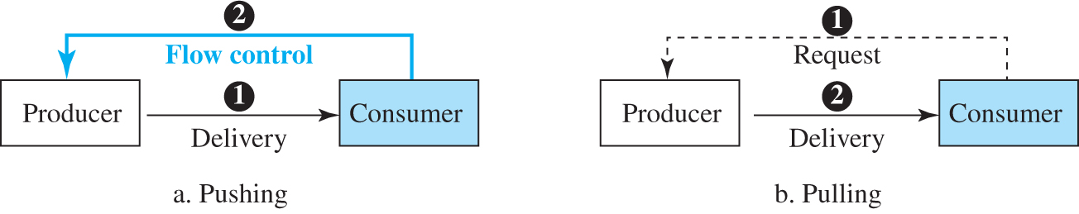
Pushing and Pooling
Delivery of items from a producer to a consumer can occur in one of two ways: pushing or pulling.
If the sender delivers items whenever they are produced without a prior request from the consumer, the delivery is referred to as pushing.
If the producer delivers the items after the consumer has requested them, the delivery is referred to as pulling.
Figure 9.9 Pushing and pulling

Slide 17
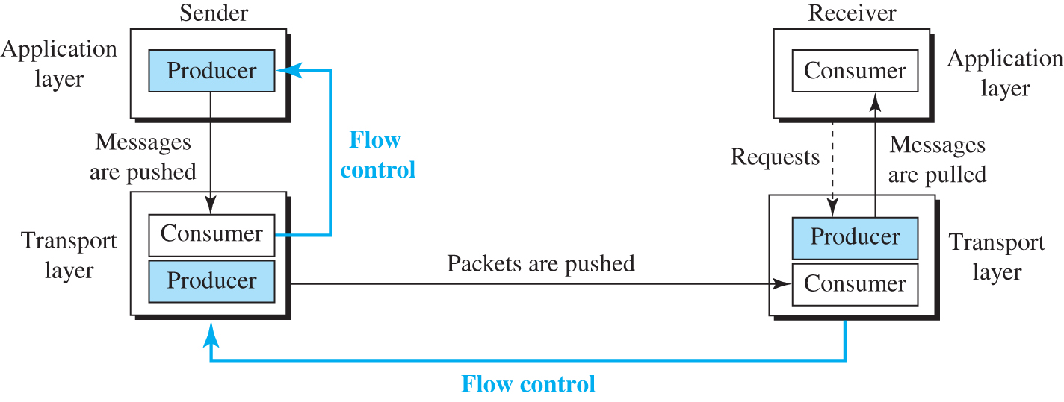
Flow control at the transport layer
Figure 9.10
Four entities involved:
sender process (Acts as producer)
sender transport layer (Acts as both consumer and producer)
receiver transport layer (Acts as both consumer and producer)
receiver process (Acts as consumer)

Slide 18
Example 9.1: Flow control using single-slot buffer
The above discussion requires that the consumers communicate with the producers on two occasions: when the buffer is full and when there are vacancies.
If the two parties use a buffer with only one slot, the communication can be easier.
Assume that each transport layer uses one single memory location to hold a packet.
When this single slot in the sending transport layer is empty, the sending transport layer sends a note to the application layer to send its next chunk; when this single slot in the receiving transport layer is empty, it sends an acknowledgment to the sending transport layer to send its next packet.
Single-slot buffer at the sender and the receiver, is inefficient.

Slide 19
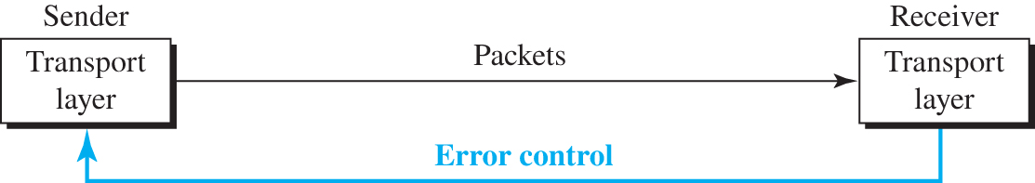
Figure 9.11 Error control at the transport layer
A sender with transport layer transmits packets to transport layer of receiver.
The process from the transport layer of the receiver to the transport layer of the sender represents error control.
Error control at the transport layer is responsible for:
Detecting and discarding corrupted packets.
Keeping track of lost and discarded packets and resending them.
Recognizing duplicate packets and discarding them.
Buffering out-of-order packets until the missing packets arrive.
Access the text alternative for slide images.

Slide 20
Combination of Flow and Error Control
Flow control requires the use of two buffers, one at the sender site and the other at the receiver site.
Error control requires the use of sequence numbers and acknowledgment numbers by both sides.
Transport layer uses Sliding Window for flow and error control

Slide 21
Sliding Window Overview
The sliding window manages how much data can be sent before needing an acknowledgment.
It uses sequence numbers that specifies the range of bytes that can be sent without receiving an acknowledgment.
This window "slides" as data is acknowledged and new data is sent.

Slide 22
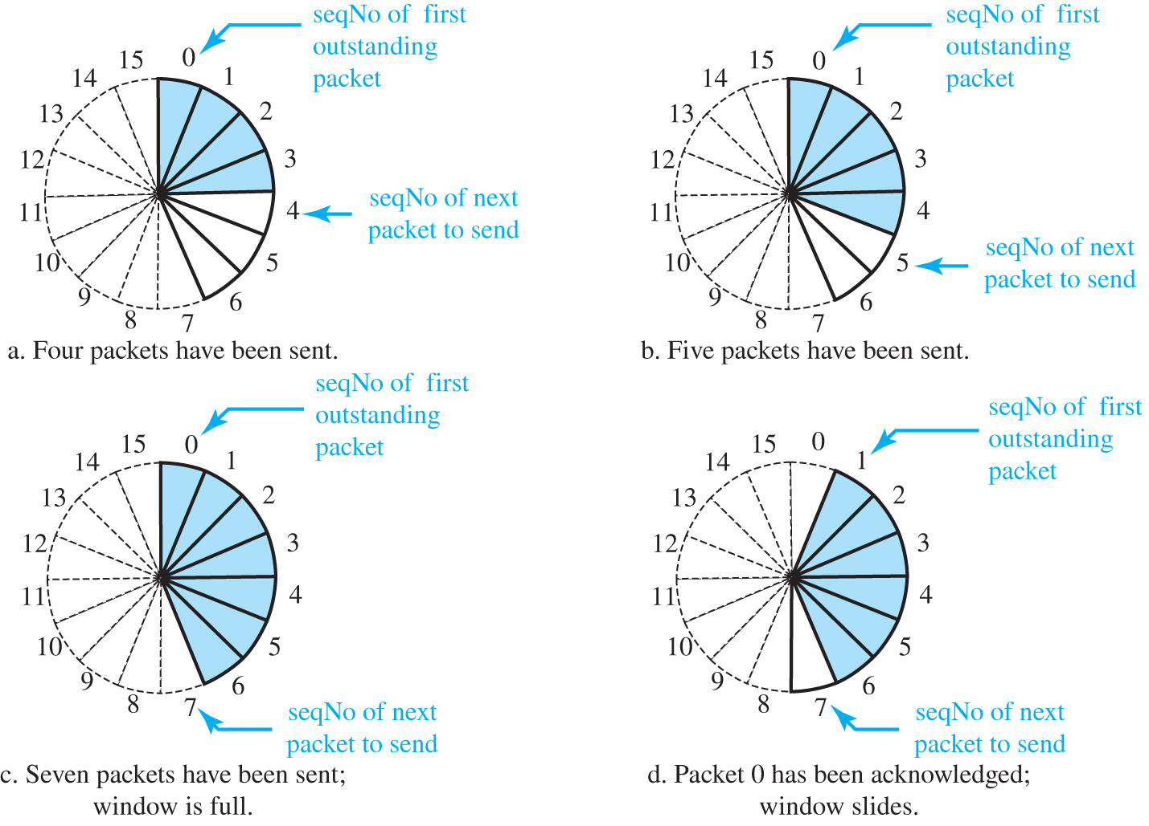
Figure 9.12 Sliding window in circular format
Send Window size=7
Access the text alternative for slide images.
Notes:
Sequence Numbers Wrap Around: TCP sequence numbers are finite, typically 32-bit, which means they wrap around after reaching a maximum value (e.g., 2^32 - 1).

Slide 23
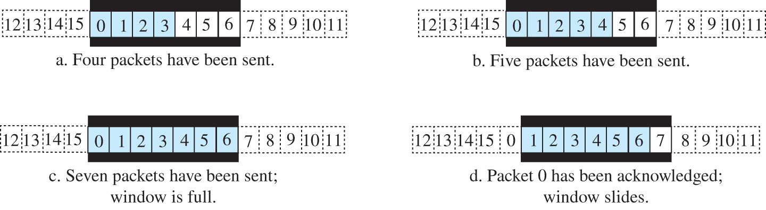
Figure 9.13 Sliding window in linear format
Send Window size=7
Access the text alternative for slide images.

Slide 24
9.1.9 Connectionless and Connection-Oriented Protocol
A transport-layer protocol, like a network-layer protocol, can provide two types of services: connectionless and connection-oriented.
The nature of these services at the transport layer, however, is different from the ones at the network layer.
At the network layer, a connectionless service may mean different paths for different datagrams belonging to the same message.
Connectionless service at the transport layer means independency between packets.
Connection-oriented at the transport layer means dependency

Slide 25
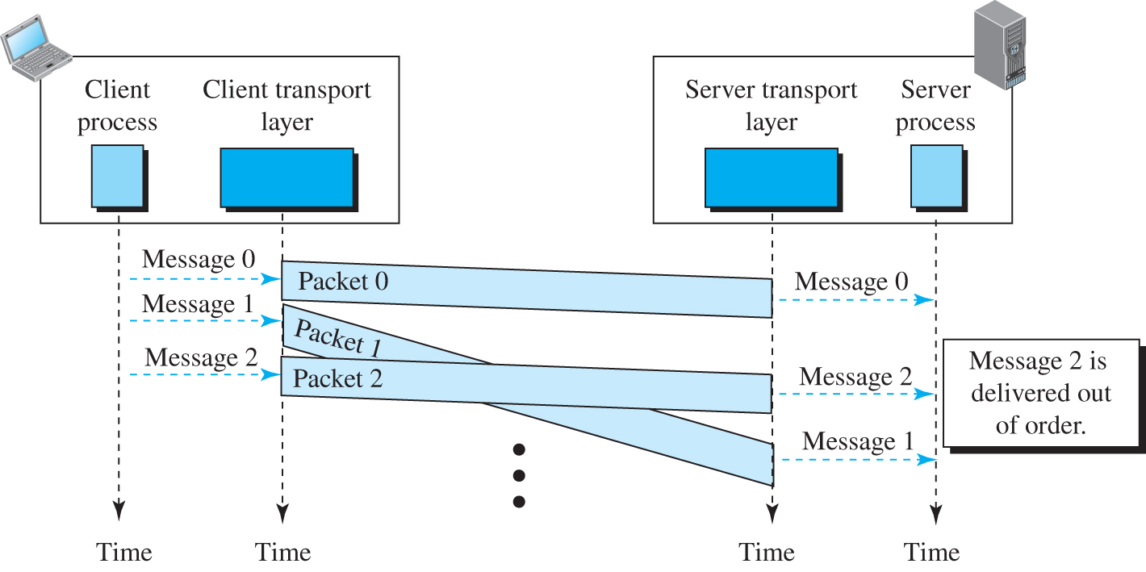
Connectionless Service
In a connectionless service, the source process needs to divide its message into chunks of data and deliver them to the transport layer one by one.
The transport layer treats each chunk as a single unit without any relation between the chunks.
The transport layer encapsulates the chunks it to packets and sends it. (Figure 9.14).
Figure 9.14

Slide 26
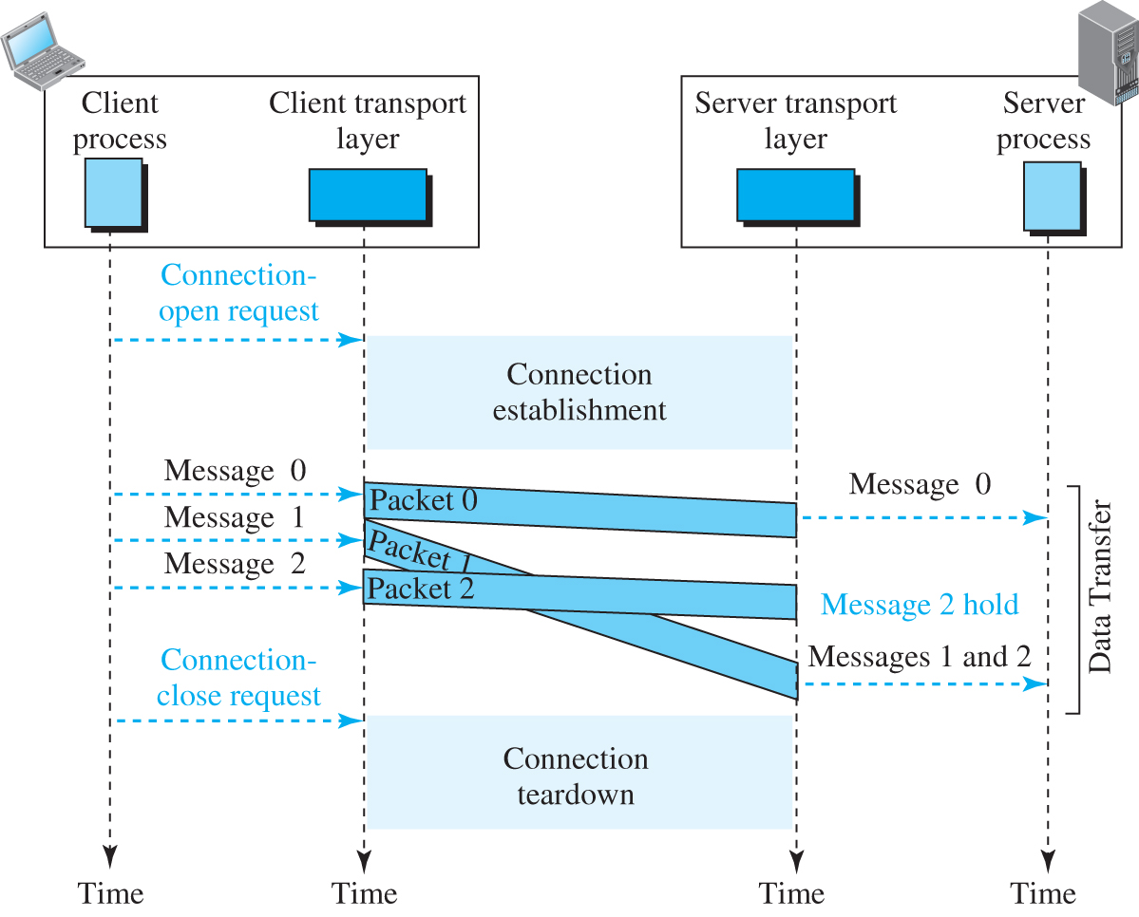
Connection-Oriented Service
In a connection-oriented service, the client and the server first need to establish a logical connection between themselves.
The data exchange can only happen after the connection establishment.
After data exchange, the connection needs to be torn down (Figure 9.15).
Figure 9.15

Slide 27
Finite State Machine
The behavior of a transport-layer protocol, both when it provides a connectionless and when it provides a connection-oriented protocol, can be better shown as a finite state machine (FSM).
Figure 9.16 shows a representation of a transport layer using an FSM.
Using this tool, each transport layer (sender or receiver) is taught as a machine with a finite number of states. The machine is always in one of the states until an event occurs.

Slide 28
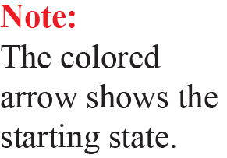
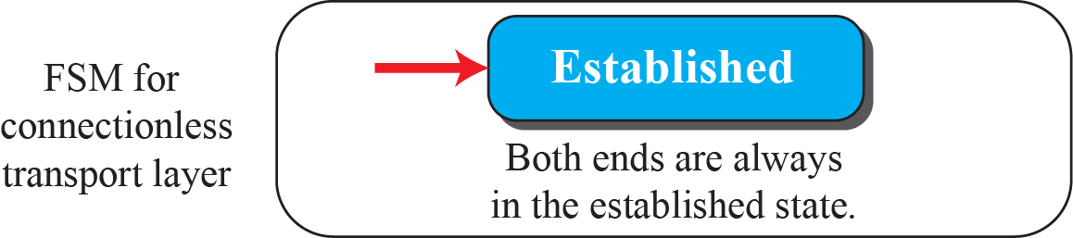
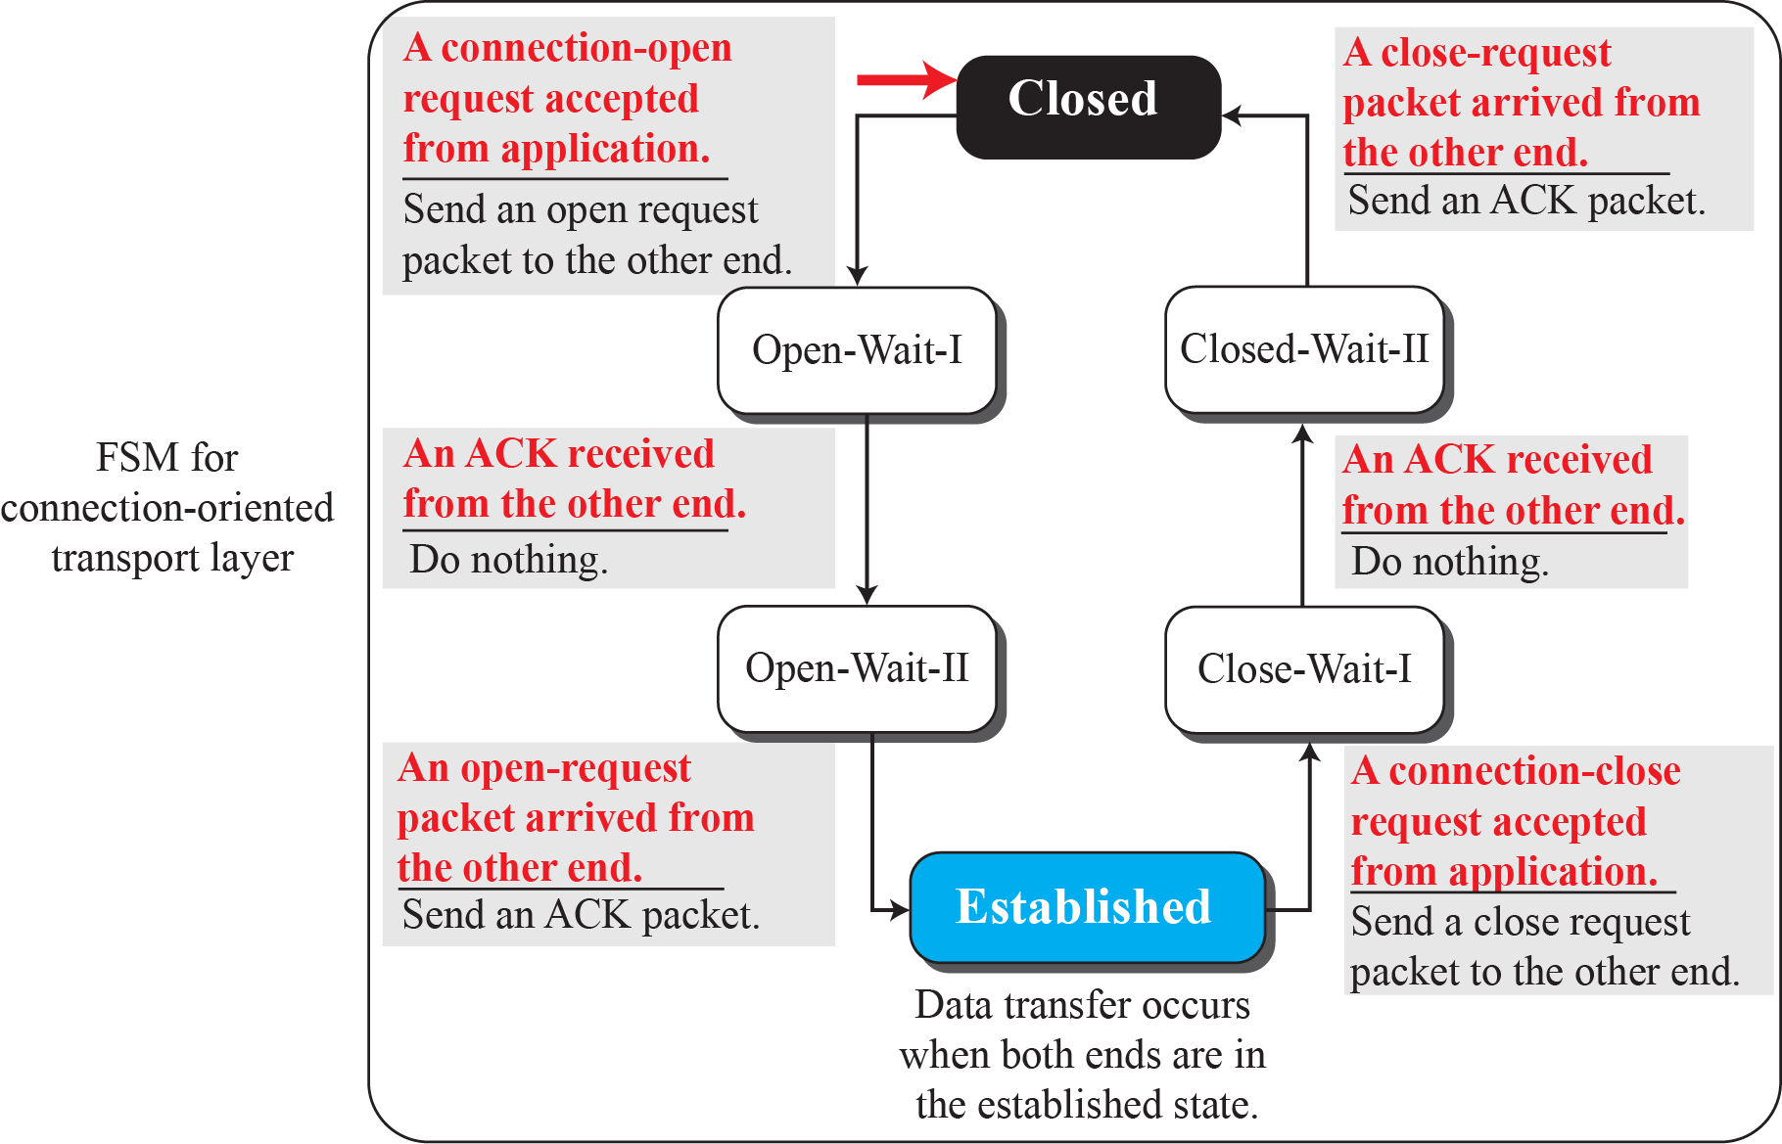
Figure 9.16: Connectionless and connection-oriented service represented as FSMs

Slide 29
Figure 9.16: Connectionless and connection-oriented service represented as FSMs
F S M for connectionless transport layer represents with color arrow established both ends are always in the established state. The F S M for connection-oriented transport layer represents A connection open request accepted from the application. Send an open-request packet to the other end with a color arrow to closed. The closed moves to Open-Wait-I, an A C K received from the other end. Do nothing. Open-Wait-I moves to Open-wait-II. An open-request packet arrived from the other end. Send an A C K packet. The open wait-II moves to established where data transfers occur when both ends are in the established state. Then moves to close-wait-I represent a connection-close request accepted from the application, send a close-request packet to the other end. The close-wait I moves to closed-wait-II represents an A C K received from the other end, do nothing. The closed-Wait-II moves to closed represent a close-request packet arrived from the other end, send an A C K packet. Note: The colored arrow shows the starting state.

Slide 30
3-2 TRANSPORT-LAYER PROTOCOLS
We can create a transport-layer protocol by combining a set of services described in the previous sections.
Flow Control and Error Control Protocols
- Simplest
-Stop-and-wait
-Go-back-N
-Selective-Repeat

Slide 31
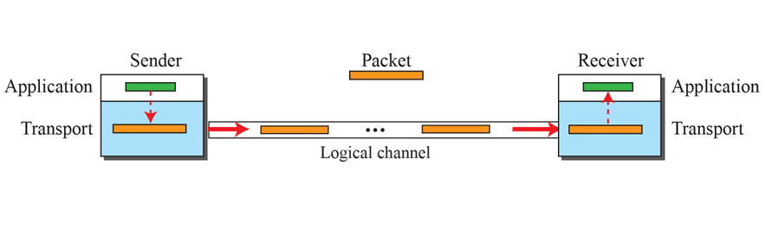
3.2.1 Simple Protocol
It is connectionless protocol with neither flow nor error control.
We assume that the receiver can immediately handle any packet it receives.
In other words, the receiver can never be overwhelmed with incoming packets.
Figure 3.17: Simple protocol

Slide 32
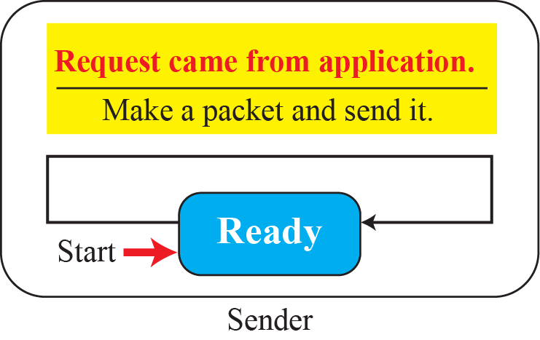
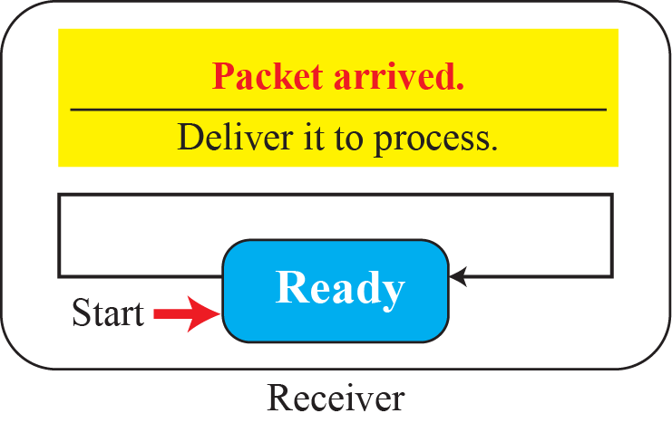
Figure 3.18: FSMs for the simple protocol

Slide 33
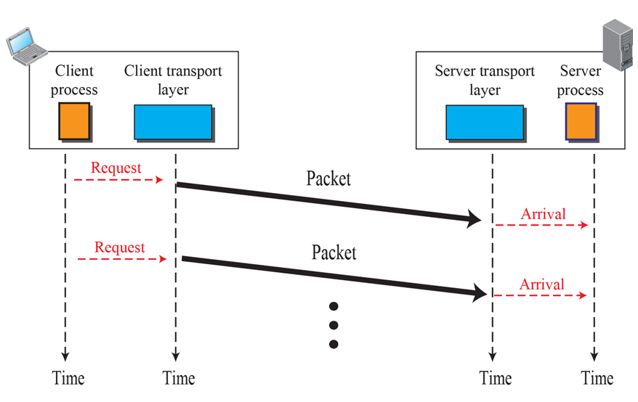
Example 3.3
Figure 3.19 shows an example of communication using this protocol. It is very simple. The sender sends packets one after another without even thinking about the receiver.
Figure 3.19: Flow diagram for Example 3.3

Slide 34
3.2.2 Stop-and-Wait Protocol
It is a connection-oriented protocol which uses both flow and error control.
Both the sender and the receiver use a sliding window of size 1.
The sender sends one packet at a time and waits for an acknowledgment before sending the next one.
To detect corrupted packets, we need to add a checksum to each data packet.
When a packet arrives at the receiver site, the receiver sends an acknowledgment (ACK) for Packet.

Slide 35
3.2.2 (continued)
Sequence Numbers for the data packets are used
Acknowledgment Numbers(ACKs) are used for the acknowledgement
FSMs represents the behavior of communication
Sender
Receiver
Efficiency

Slide 36
Figure 3.20: Stop-and-Wait protocol

Slide 37
Figure 3.21: FSM for the Stop-and-Wait protocol

Slide 38
Example 3.4
Figure 3.22 shows an example of the Stop-and-Wait protocol. Packet 0 is sent and acknowledged. Packet 1 is lost and resent after the time-out. The resent packet 1 is acknowledged and the timer stops. Packet 0 is sent and acknowledged, but the acknowledgment is lost. The sender has no idea if the packet or the acknowledgment is lost, so after the time-out, it resends packet 0, which is acknowledged.

Slide 39
Figure 3.22: Flow diagram for Example 3.4

Slide 40
Example 3.5
Assume that, in a Stop-and-Wait system, the bandwidth of the line is 1 Mbps, and 1 bit takes 20 milliseconds to make a round trip. What is the bandwidth-delay product? If the system data packets are 1,000 bits in length, what is the utilization percentage of the link?
Solution
The bandwidth-delay product is (1 × 10⁶) × (20 × 10⁻³) = 20,000 bits. The system can send 20,000 bits during the time it takes for the data to go from the sender to the receiver and the acknowledgment to come back. However, the system sends only 1,000 bits. The link utilization is only 1,000/20,000, or 5 percent.

Slide 41
Example 3.6
What is the utilization percentage of the link in Example 3.5 if we have a protocol that can send up to 15 packets before stopping and worrying about the acknowledgments?
Solution
The bandwidth-delay product is still 20,000 bits. The system can send up to 15 packets or 15,000 bits during a round trip. This means the utilization is 15,000/20,000, or 75 percent. Of course, if there are damaged packets, the utilization percentage is much less because packets have to be resent.

Slide 42
Limitation of Stop and Wait protocol
It is inefficient for high-speed networks with long delays because the sender waits for an acknowledgment after each packet is sent.
Go-Back-N Protocol can be used which is based on Sliding Window, where multiple packets are sent before needing an acknowledgment.

Slide 43
3.2.3 Go-Back-N Protocol
Allows multiple packets to be sent before waiting for an acknowledgment.
If an error is detected, all packets from the erroneous packet onward must be retransmitted.
It uses Sliding Window

Slide 44
3.2.3 Go-Back-N Protocol
Sequence Numbers
Acknowledgment Numbers
Send Window
Receive Window
Timers
Resending packets
FSMs
Sender
Receiver
Send Window Size
Go-Back-N versus Stop-and-Wait

Slide 45
Figure 3.23: Go-Back-N protocol

Slide 46
Figure 3.24: Send window for Go-Back-N

Slide 47
Figure 3.25: Sliding the send window
Sliding direction

Slide 48
Figure 3.26: Receive window for Go-Back-N

Slide 49
Figure 3.27: FSMs for the Go-Back-N protocol

Slide 50
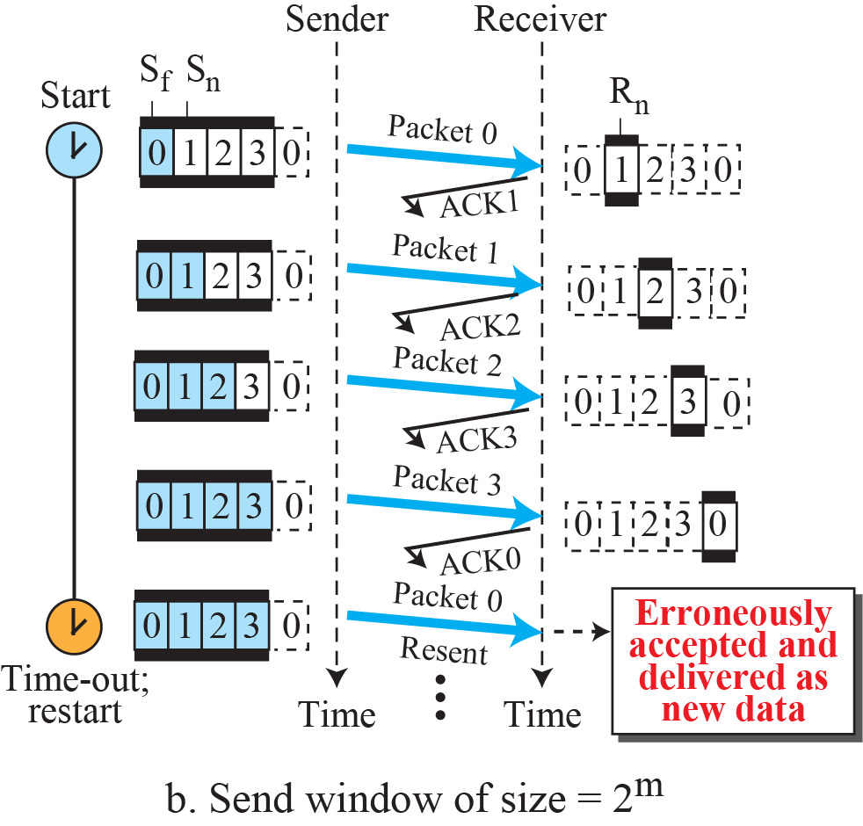
Figure 3.28: Send window size for Go-Back-N

Slide 51
Example 3.7
Figure 3.29 shows an example of Go-Back-N. This is an example of a case where the forward channel is reliable, but the reverse is not. No data packets are lost, but some ACKs are delayed and one is lost. The example also shows how cumulative acknowledgments can help if acknowledgments are delayed or lost.

Slide 52
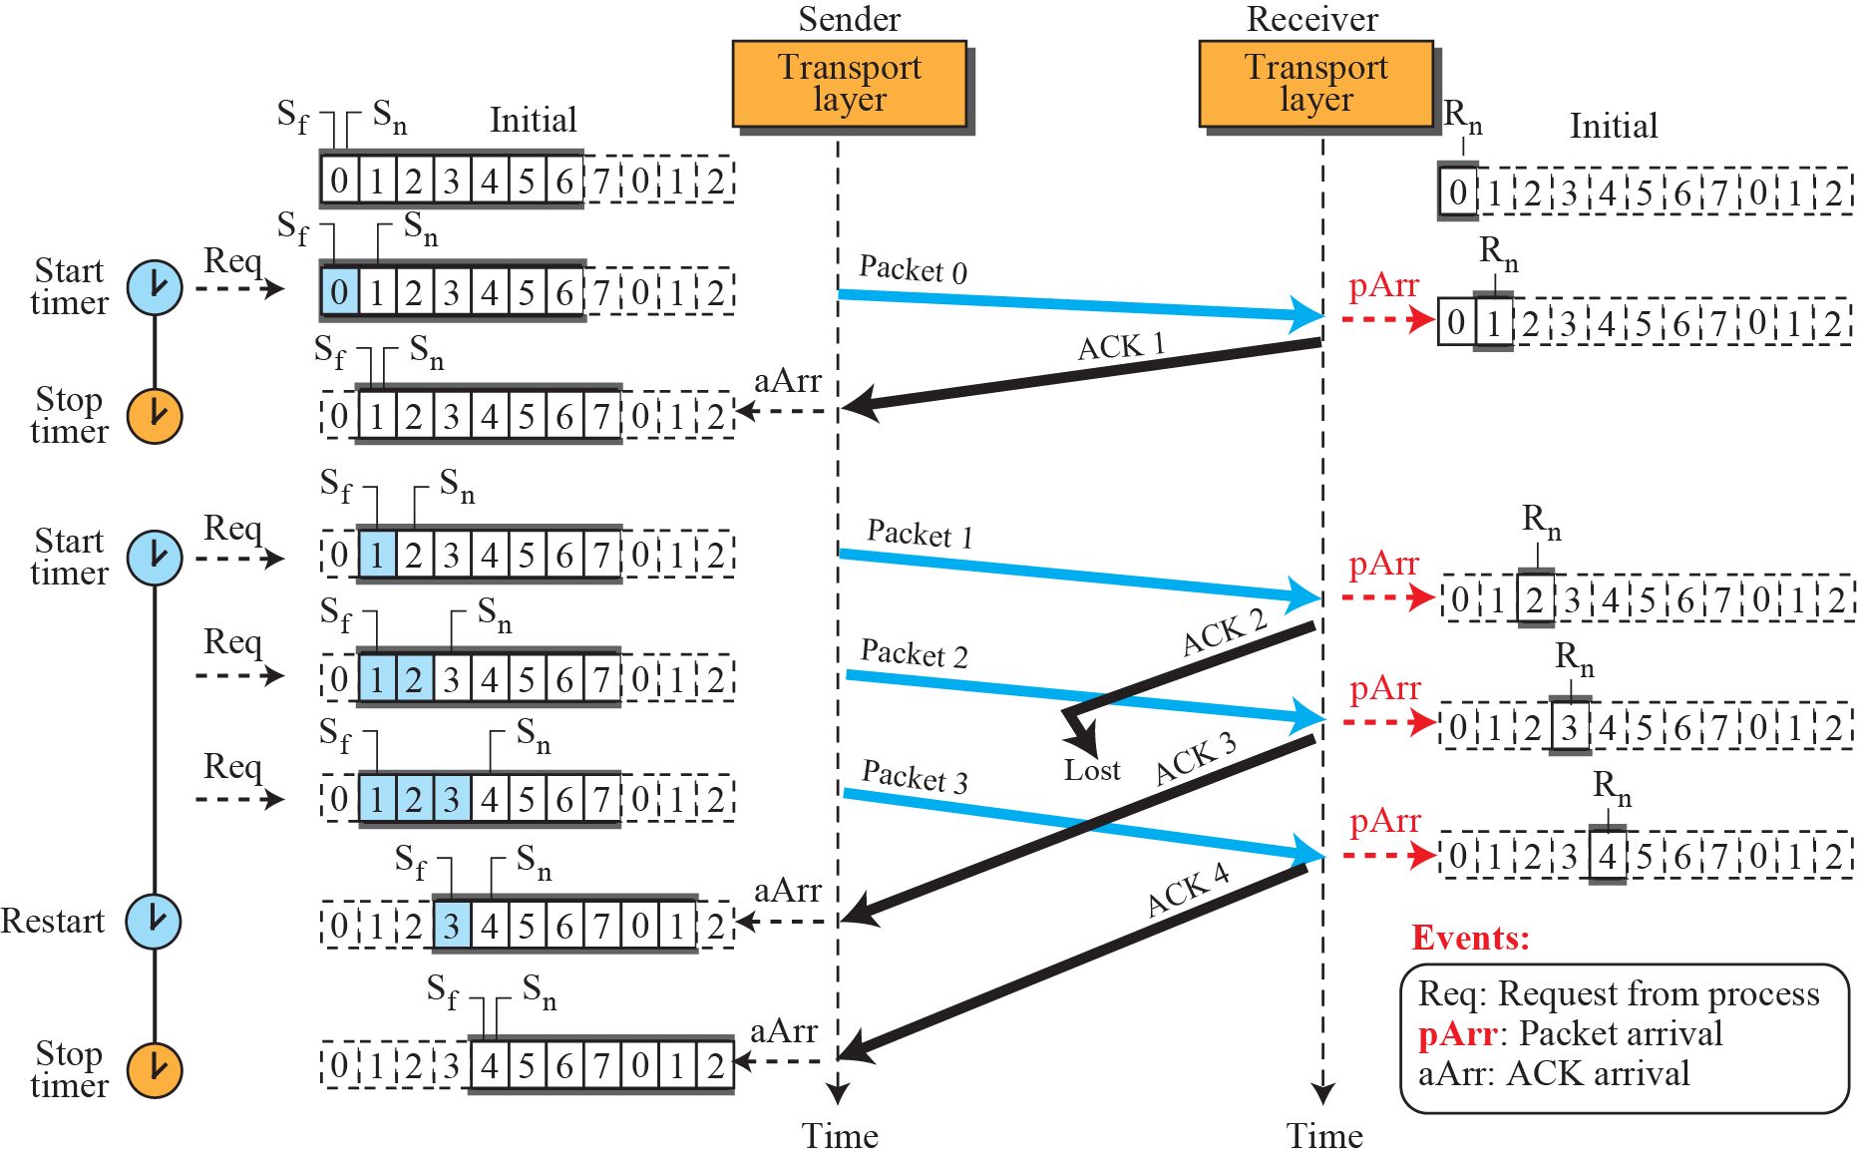
Figure 3.29: Flow diagram for Example 3.7

Slide 53
Example 3.8
Figure 3.30 shows what happens when a packet is lost. Packets 0, 1, 2, and 3 are sent. However, packet 1 is lost. The receiver receives packets 2 and 3, but they are discarded because they are received out of order (packet 1 is expected). When the receiver receives packets 2 and 3, it sends ACK1 to show that it expects to receive packet 1. However, these ACKs are not useful for the sender because the ackNo is equal to S_{f}, not greater that S_{f} . So the sender discards them. When the time-out occurs, the sender resends packets 1, 2, and 3, which are acknowledged.

Slide 54
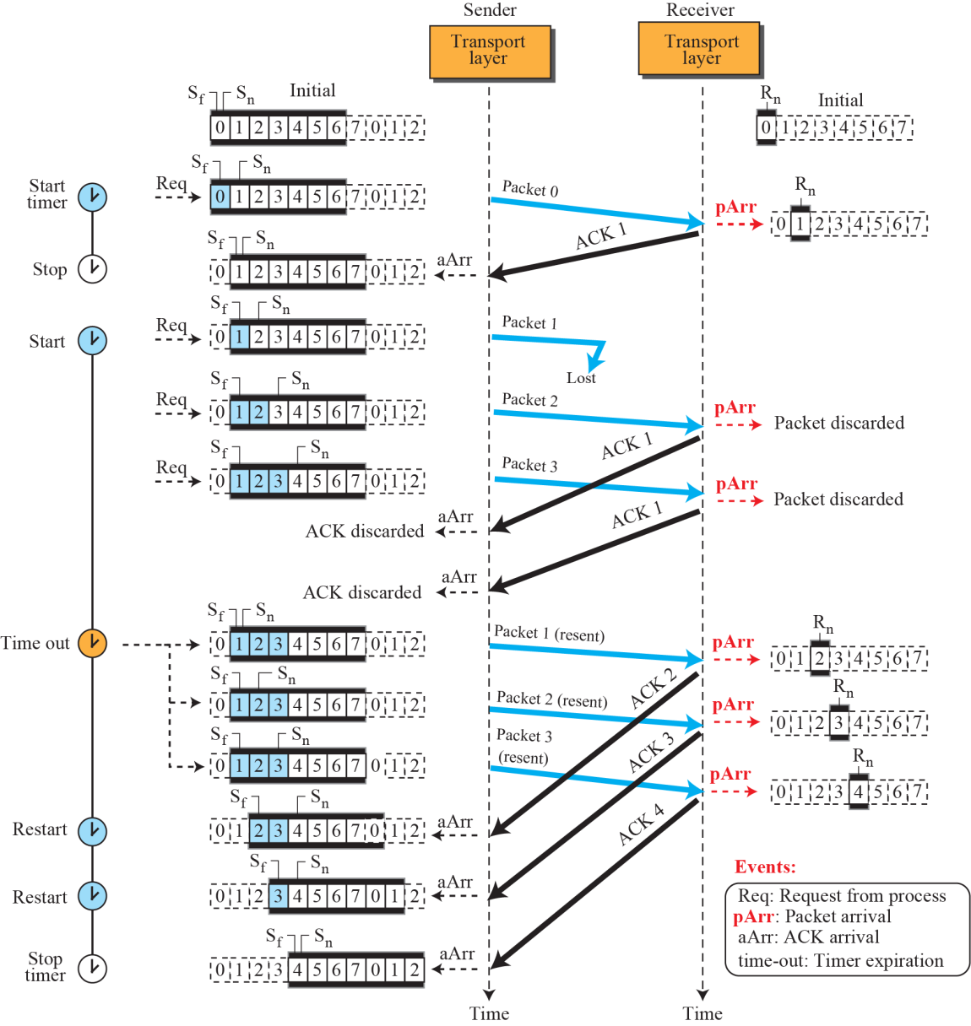
Figure 3.30: Flow diagram for Example 3.8

Slide 55
3.2.4 Selective-Repeat Protocol
The Go-Back-N protocol simplifies the process at the receiver. The receiver keeps track of only one variable, and there is no need to buffer out-of-order packets; they are simply discarded. Another protocol, called the Selective-Repeat (SR) protocol, has been devised, which, as the name implies, resends only selective packets, those that are actually lost. The outline of this protocol is shown in Figure 3.31.

Slide 56
3.2.4 (continued)
Windows
Timer
Acknowledgments
FSMs
Sender
Receiver

Slide 57
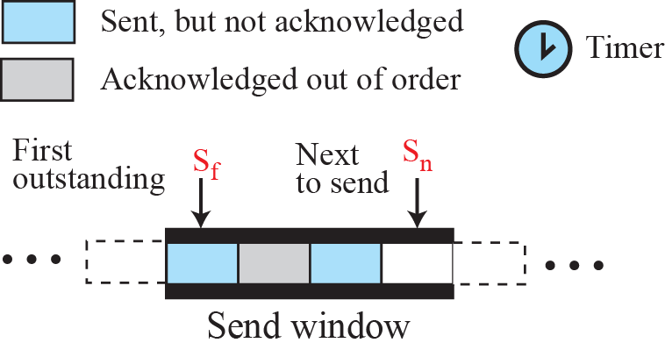
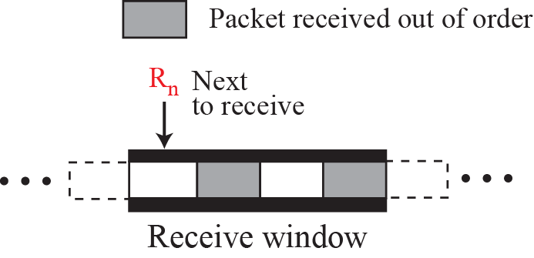
Figure 3.31: Outline of Selective-Repeat

Slide 58
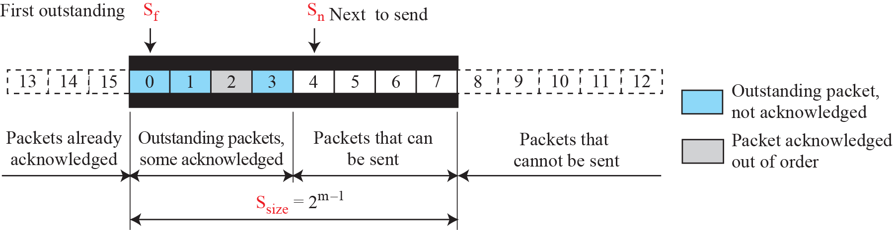
Figure 3.32: Send window for Selective-Repeat protocol

Slide 59
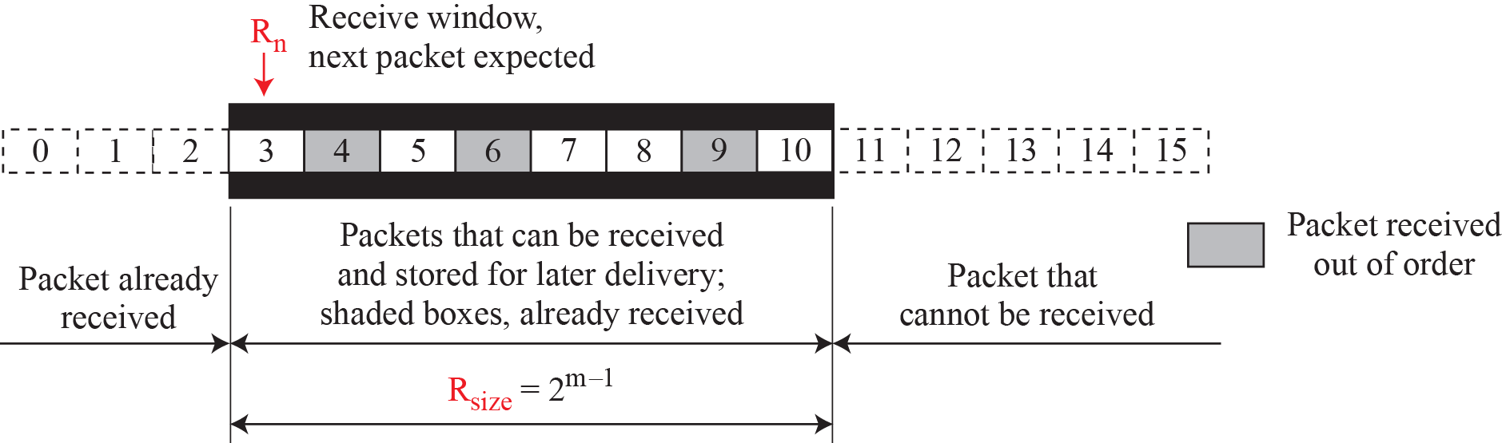
Figure 3.33: Receive window for Selective-Repeat protocol

Slide 60
Example 3.9
Assume a sender sends 6 packets: packets 0, 1, 2, 3, 4, and 5. The sender receives an ACK with ackNo = 3. What is the interpretation if the system is using GBN or SR?
Solution
If the system is using GBN, it means that packets 0, 1, and 2 have been received uncorrupted and the receiver is expecting packet 3. If the system is using SR, it means that packet 3 has been received uncorrupted; the ACK does not say anything about other packets.

Slide 61
Figure 3.34: FSMs for SR protocol

Slide 62
Example 3.10
This example is similar to Example 3.8 (Figure 3.30) in which packet 1 is lost. We show how Selective-Repeat behaves in this case. Figure 3.35 shows the situation.
At the sender, packet 0 is transmitted and acknowledged. Packet 1 is lost. Packets 2 and 3 arrive out of order and are acknowledged. When the timer times out, packet 1 (the only unacknowledged packet) is resent and is acknowledged. The send window then slides.

Slide 63
Example 3.10 (continued)
At the receiver site we need to distinguish between the acceptance of a packet and its delivery to the application layer. At the second arrival, packet 2 arrives and is stored and marked (shaded slot), but it cannot be delivered because packet 1 is missing. At the next arrival, packet 3 arrives and is marked and stored, but still none of the packets can be delivered. Only at the last arrival, when finally a copy of packet 1 arrives, can packets 1, 2, and 3 be delivered to the application layer. There are two conditions for the delivery of packets to the application layer: First, a set of consecutive packets must have arrived. Second, the set starts from the beginning of the window.

Slide 64
Figure 3.35: Flow diagram for Example 3.10

Slide 65
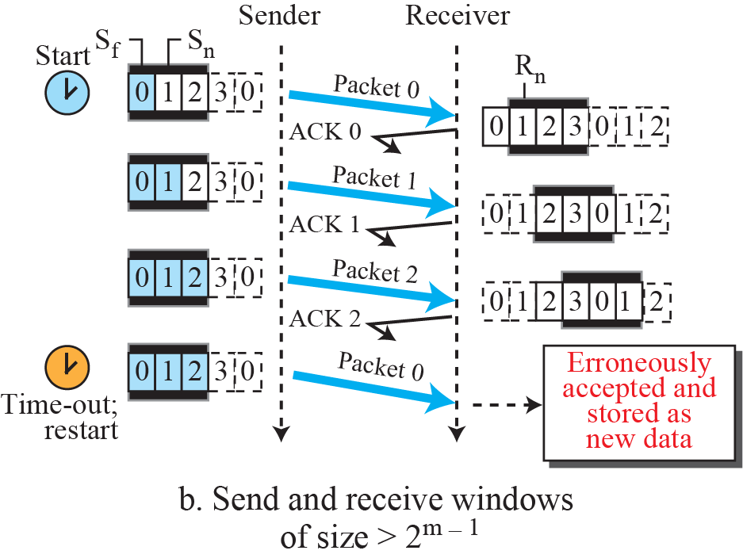
Figure 3.36: Selective-Repeat, window size

Slide 66
3.2.5 Bidirectional Protocols
The four protocols we discussed earlier in this section are all unidirectional: data packets flow in only one direction and acknowledgments travel in the other direction. In real life, data packets are normally flowing in both directions: from client to server and from server to client. This means that acknowledgments also need to flow in both directions. A technique called piggybacking is used to improve the efficiency of the bidirectional protocols.

Slide 67
Figure 3.37: Design of piggybacking in Go-Back-N

Slide 68
9-2 TRANSPORT-LAYER PROTOCOLS
After discussing the general principle behind the transport layer in the previous section, we concentrate on the transport protocols in the Internet in this section. shows the position of these three protocols in the TCP/IP protocol suite: UDP, TCP, and SCTP.

Slide 69
Figure 9.17 Position of transport-layer protocols in the TCP/IP protocol suite
Access the text alternative for slide images.

Slide 70
9.2.2 Port Numbers
A transport-layer protocol usually has several responsibilities. One is to create a process-to-process communication; these protocols use port numbers to accomplish this. Port numbers provide end-to-end addresses at the transport layer and allow multiplexing and de-multiplexing at this layer, just as IP addresses do at the network layer. Table 9.1 gives some common port numbers for all three protocols we discuss in this chapter.

Slide 71
Table 9.1 Some well-known ports used with UDP and TCP
Port | Protocol | UDP | TCP | SCTP | Description
7 | Echo | √ | √ | √ | Echoes back a received datagram
9 | Discard | √ | √ | √ | Discards any datagram that is received
11 | Users | √ | √ | √ | Active users
13 | Daytime | √ | √ | √ | Returns the date and the time
17 | Quote | √ | √ | √ | Returns a quote of the day
19 | Chargen | √ | √ | √ | Returns a string of characters
20 | FTP-data |  | √ | √ | File Transfer Protocol
21 | FTP-21 |  | √ | √ | File Transfer Protocol
23 | TELNET |  | √ | √ | Terminal Network
25 | SMTP |  | √ | √ | Simple Mail Transfer Protocol
53 | DNS | √ | √ | √ | Domain Name System
67 | DHCP | √ | √ | √ | Dynamic Host Configuration Protocol
69 | TFTP | √ | √ | √ | Trivial File Transfer Protocol
80 | HTTP |  | √ | √ | Hypertext Transfer Protocol
111 | RPC | √ | √ | √ | Remote Procedure Call
123 | NTP | √ | √ | √ | Network Time Protocol
161 | SNMP-server | √ |  |  | Simple Network Management Protocol
162 | SNMP-client | √ |  |  | Simple Network Management Protocol

Slide 72
9-3 USER DADAGRAM PROTOCOL (UDP)
The User Datagram Protocol (UDP) is a connectionless, unreliable transport protocol.
It does not add anything to the services of IP except for providing process-to-process instead of host-to-host communication.
UDP is a very simple protocol using a minimum of overhead.

Slide 73
Figure 9.18 User datagram packet format
UDP packets, called user datagrams, have a fixed size header of 8 bytes made of four fields, each of 2 bytes (16 bits). Figure 9.18 shows the format of a user datagram.
The first two fields define the source and destination port numbers. The third field defines the total length of the user datagram, header plus data. The 16 bits can define a total length of 0 to 65,535 bytes.

Slide 74
Example 9.2 (1)
The following is the contents of a UDP header in hexadecimal format.
CB84000D001C001C
What is the source port number?
What is the destination port number?
What is the total length of the user datagram?
What is the length of the data?
Is the packet directed from a client to a server or vice versa?
What is the client process?

Slide 75
Example 9.2 (2)
Solution
The source port number is the first four hexadecimal digits (CB84)₁₆ or 52100
The destination port number is the second four hexadecimal digits (000D)₁₆ or 13.
The third four hexadecimal digits (001C)₁₆ define the length of the whole UDP packet as 28 bytes.
The length of the data is the length of the whole packet minus the length of the header, or 28 − 8 = 20 bytes.
Since the destination port number is 13 (well-known port), the packet is from the client to the server.
The client process is the Daytime.

Slide 76
9.3.1 UDP Services
Process-to-Process Communication 1
UDP provides process-to-process communication using socket addresses, a combination of IP addresses and port numbers.
Connectionless Services
As mentioned previously, UDP provides a connectionless service. This means that each user datagram sent by UDP is an independent datagram. There is no relationship between the different user datagrams even if they are coming from the same source process and going to the same destination program. The user datagrams are not numbered.

Slide 77
9.3.1 UDP Services
Lack of Flow Control
UDP is a very simple protocol. There is no flow control, and hence no window mechanism. The receiver may overflow with incoming messages. The lack of flow control means that the process using UDP should provide for this service, if needed.
Lack of Error Control
There is no error control mechanism in UDP except for the checksum. This means that the sender does not know if a message has been lost or duplicated. When the receiver detects an error through the checksum, the user datagram is silently discarded. The lack of error control means that the process using UDP should provide for this service, if needed.

Slide 78
Checksum
UDP checksum calculation includes three sections: a pseudo-header, the UDP header, and the data coming from the application layer. The pseudo-header is the part of the header of the IP packet in which the user datagram is to be encapsulated with some fields filled with 0s.
Figure 9.19 Pseudoheader for checksum calculation

Slide 79
Example 9.3
What value is sent for the checksum in one of the following hypothetical situations?
The sender decides not to include the checks
The sender decides to include the checksum, but the value of the sum is all 1s.
The sender decides to include the checksum, but the value of the sum is all 0s.

Slide 80
Example 9.3 Solution
The value sent for the checksum field is all 0s to show that the checksum is not -calculated.
When the sender complements the sum, the result is all 0s; the sender complements the result again before sending. The value sent for the checksum is all 1s. The second -complement operation is needed to avoid confusion with the case in part a.
This situation never happens because it implies that the value of every term included in the calculation of the sum is all 0s, which is impossible; some fields in the pseudo-header have nonzero values.

Slide 81
9.3.1 UDP Services
Lack of Congestion Control
Since UDP is a connectionless protocol, it does not provide congestion control. UDP assumes that the packets sent are small and sporadic and cannot create congestion in the network. This assumption may or may not be true today, when UDP is used for interactive real-time transfer of audio and video.
Encapsulation and Decapsulation
To send a message from one process to another, the UDP protocol encapsulates and decapsulates messages.

Slide 82
9.3.1 UDP Services
Queuing in UDP
In UDP, queues are associated with ports.
At the client site, when a process starts, it requests a port number from the operating system.
Some implementations create both an incoming and an outgoing queue associated with each process.
Other implementations create only an incoming queue associated with each process.

Slide 83
9.3.1 UDP Services
Multiplexing and Demultiplexing
In a host running a TCP/IP protocol suite, there is only one UDP but possibly several processes that may want to use the services of UDP. To handle this situation, UDP multiplexes and demultiplexes.
Comparison with other connectionless protocols
Unlike other connectionless protocols, UDP provides an optional checksum to detect corrupted packets at the receiver site.
If the checksum is added to the packet, the receiving UDP can check the packet and discard the packet if it is corrupted.
No feedback, however, is sent to the sender.

Slide 84
9.3.2 UDP Applications
Although UDP meets almost none of the criteria we mentioned earlier for a reliable transport-layer protocol, UDP is preferable for some applications. The reason is that some services may have some side effects that are either unacceptable or not preferable. An application designer sometimes needs to compromise to get the optimum. For example, in our daily life, we all know that a one-day delivery of a package by a carrier is more expensive than a three-day delivery. Although high speed and low cost are both desirable features in delivery of a parcel, they are in conflict with each other.

Slide 85
When to Use UDP
Real-Time Applications: When low latency and timely delivery are critical, and some packet loss is acceptable.
Simple Request-Response Protocols: When you need a lightweight protocol for simple queries and responses.
Multimedia Streaming: For live audio and video where occasional packet loss doesn’t significantly impact the experience.

Slide 86
Typical Applications of UDP
UDP is suitable for a process that requires simple request-response communication with little concern for flow and error control.
UDP is suitable for a process with internal flow- and error-control mechanisms.
UDP is a suitable transport protocol for multicasting.
UDP is used for management processes such as SNMP.
UDP is used for some route updating protocols such as Routing Information Protocol (RIP).
UDP is normally used for interactive real-time applications that cannot tolerate uneven delay between sections of a received message.

Slide 87
Key Features of UDP
Connectionless.
Unreliable Delivery
No Congestion Control
Low Overhead
Simpler Protocol

Slide 88
Common UDP Use Cases
DNS (Domain Name System): DNS queries and responses use UDP because the queries are typically short and require quick responses.
VoIP (Voice over IP): Services like Skype or Zoom use UDP for voice communication because it minimizes latency and provides real-time interaction.
Streaming Media: Video and audio streaming services often use UDP to avoid delays and provide smooth playback, even if some packets are lost.
Online Gaming: Many multiplayer online games use UDP to reduce lag and latency, prioritizing real-time performance over reliability.
TFTP (Trivial File Transfer Protocol): A simpler file transfer protocol that uses UDP, typically for transferring small files or bootstrapping devices.
NTP (Network Time Protocol): NTP uses UDP to synchronize clocks between computers on a network.

Slide 89
Example 9.4
A client-server application such as DNS uses the services of UDP because a client needs to send a short request to a server and to receive a quick response from it.
The request and response can each fit in one user datagram. Since only one message is exchanged in each direction, the connectionless feature is not an issue; the client or server does not worry that messages are delivered out of order.

Slide 90
Example 9.5
A client-server application such as SMTP, which is used in electronic mail, cannot use the services of UDP because a user can send a long e-mail message, which may include multimedia (images, audio, or video). If the application uses UDP and the message does not fit in one single user datagram, the message must be split by the application into different user datagrams. Here the connectionless service may create problems. The user datagrams may arrive and be delivered to the receiver application out of order. The receiver application may not be able to reorder the pieces. This means the connectionless service has a disadvantage for an application program that sends long messages.

Slide 91
Example 9.6
Assume we are downloading a very large text file from the Internet. We definitely need to use a transport layer that provides reliable service. We don’t want part of the file to be missing or corrupted when we open the file. The delay created between the deliveries of the parts is not an overriding concern for us; we wait until the whole file is composed before looking at it. In this case, UDP is not a suitable transport layer.

Slide 92
Example 9.7
Assume we are using a real-time interactive application, such as Skype. Audio and video are divided into frames and sent one after another. If the transport layer is supposed to resend a corrupted or lost frame, the synchronizing of the whole transmission may be lost. The viewer suddenly sees a blank screen and needs to wait until the second transmission arrives. This is not tolerable. However, if each small part of the screen is sent using one single user datagram, the receiving UDP can easily ignore the corrupted or lost packet and deliver the rest to the application program. That part of the screen is blank for a very short period of time, which most viewers do not even notice.

Slide 93
3-4 TRANSMISSION CONTROL PROTOCOL
Transmission Control Protocol (TCP) is a connection-oriented, reliable protocol. TCP explicitly defines connection establishment, data transfer, and connection teardown phases to provide a connection-oriented service. TCP uses a combination of GBN and SR protocols to provide reliability.

Slide 94
3.4.1 TCP Services
A Before discussing TCP in detail, let us explain the services offered by TCP to the processes at the application layer.
Process-to-Process Communication
Stream Delivery Service
Sending and Receiving Buffers
Segments

Slide 95
3.4.1 (continued)
Full-Duplex Communication
Multiplexing and Demultiplexing
Connection-Oriented Service
Reliable Service

Slide 96
Figure 3.41: Stream delivery

Slide 97
Figure 3.42: Sending and receiving buffers

Slide 98
Figure 3.43: TCP segments

Slide 99
3.4.2 TCP Features
To provide the services mentioned in the previous section, TCP has several features that are briefly summarized in this section and discussed later in detail.
Numbering System
Byte Number
Sequence Number
Acknowledgment Number

Slide 100
Example 3.17
Suppose a TCP connection is transferring a file of 5,000 bytes. The first byte is numbered 10,001. What are the sequence numbers for each segment if data are sent in five segments, each carrying 1,000 bytes?
Solution
The following shows the sequence number for each segment:

Slide 101
3.4.3 Segment
Before discussing TCP in more detail, let us discuss the TCP packets themselves. A packet in TCP is called a segment.
Format
Encapsulation

Slide 102
Figure 3.44: TCP segment format

Slide 103
Figure 3.45: Control field

Slide 104
3.4.4 A TCP Connection
TCP is connection-oriented. As discussed before, a connection-oriented transport protocol establishes a logical path between the source and destination. All of the segments belonging to a message are then sent over this logical path. Using a single logical pathway for the entire message facilitates the acknowledgment process as well as retransmission of damaged or lost frames.

Slide 105
3.4.4 (continued)
Connection Establishment
Three-Way Handshaking
SYN Flooding Attack
Data Transfer
Pushing Data
Urgent Data
Connection Termination
Three-Way Handshaking
Half-Close
Connection Reset

Slide 106
Figure 3.47: Connection establishment using three-way handshaking

Slide 107

Figure 3.48: Data transfer

Slide 108
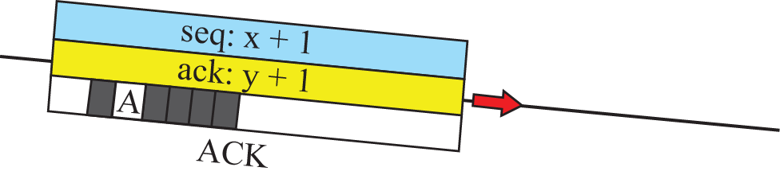
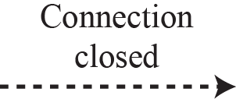
Figure 3.49: Connection termination using three-way handshaking

Slide 109
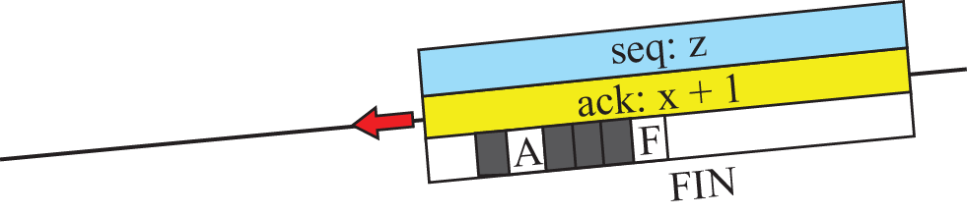
Figure 3.50: Half-close

Slide 110
3.4.5 State Transmission Diagram
To keep track of all the different events happening during connection establishment, connection termination, and data transfer, TCP is specified as the finite state machine (FSM) as shown in Figure 3.51.
Scenarios
A Half-Close Scenario

Slide 111
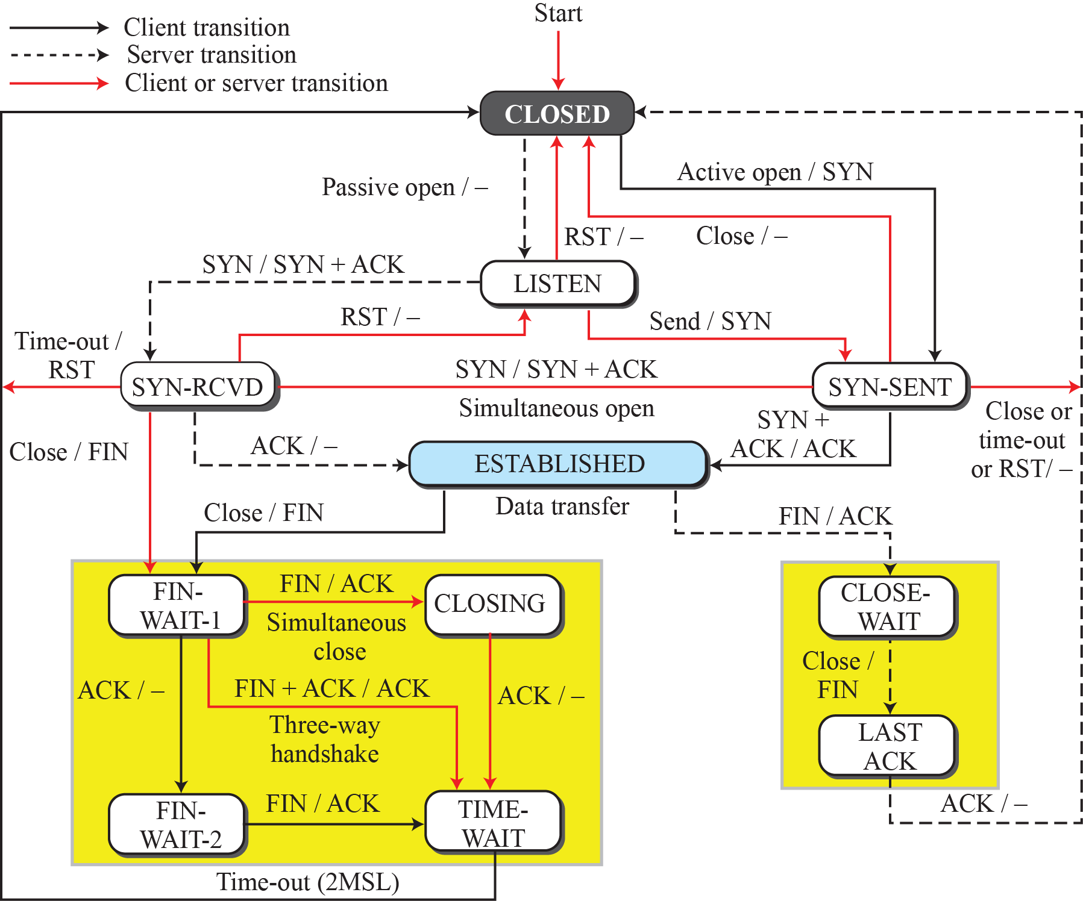
Figure 3.51: State transition diagram

Slide 112
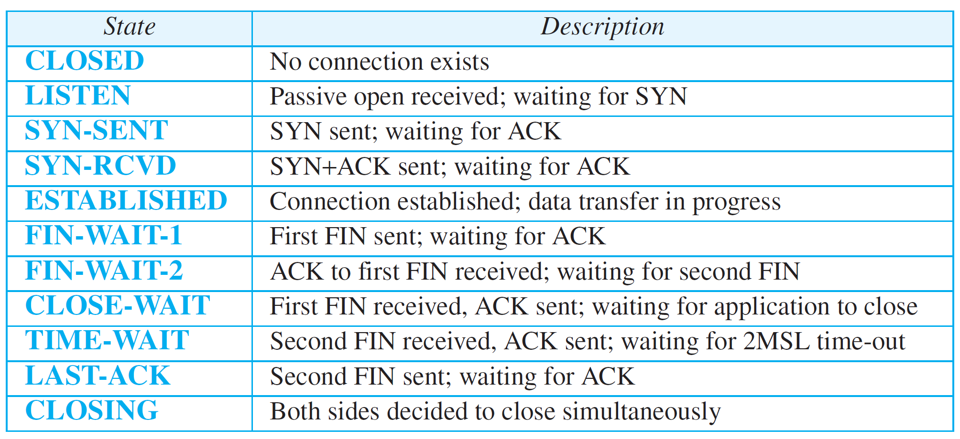
Table 3.2:States for TCP

Slide 113
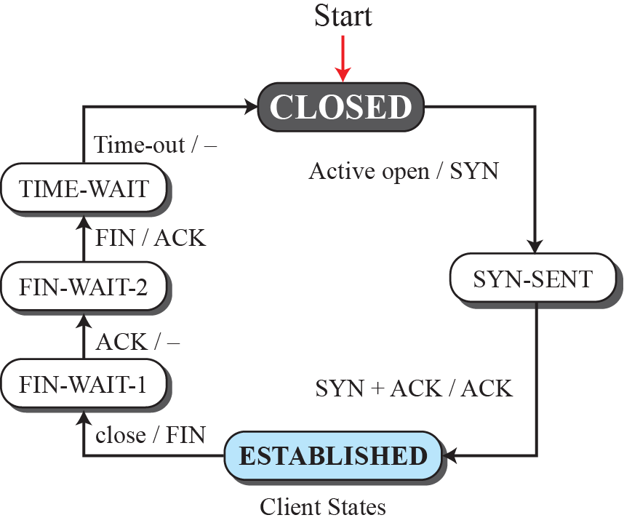
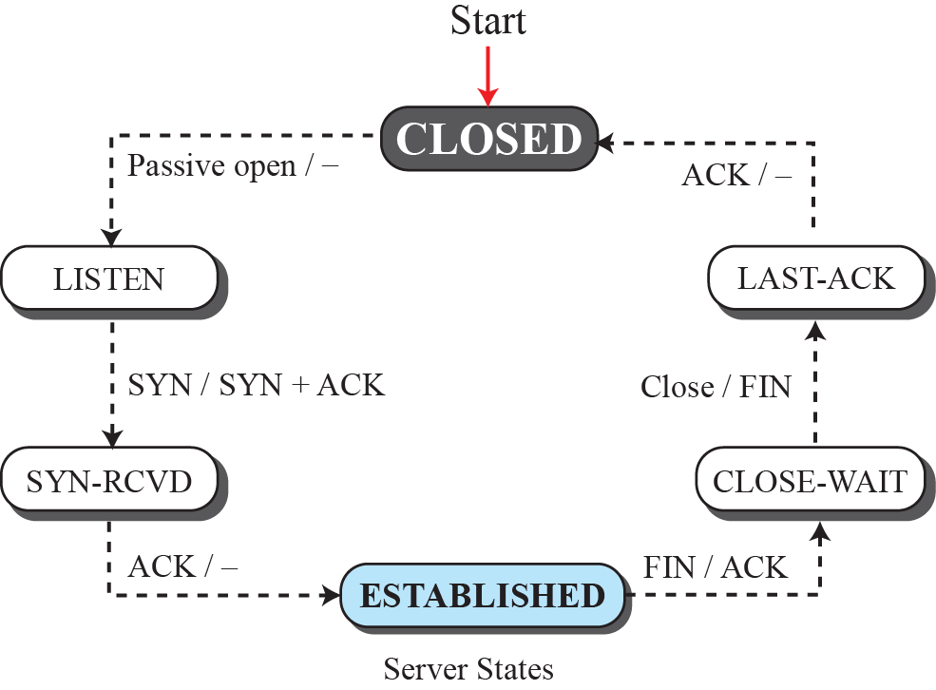
Figure 3.52: Transition diagram with half-close connection termination

Slide 114
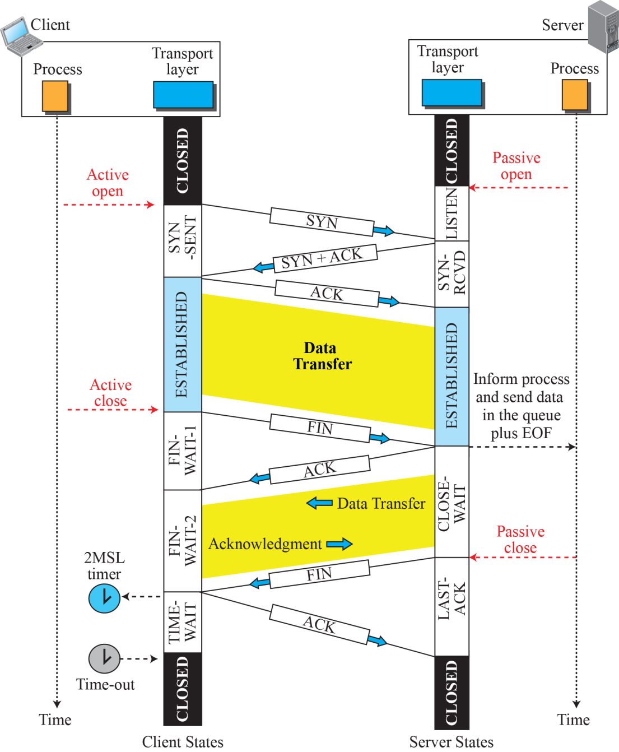
Figure 3.53: Time-line diagram for a common scenario

Slide 115
3.4.6 Windows in TCP
TCP uses two windows (send window and receive window) for each direction of data transfer, which means four windows for a bidirectional communication. To make the discussion simple, we make an unrealistic unidirectional; the bidirectional communication can be inferred using two unidirectional communications with piggybacking.
Send Window
Receive Window

Slide 116
Figure 3.54: Send window in TCP

Slide 117
Figure 3.55: Receive window in TCP

Slide 118
3.4.7 Flow Control
As discussed before, flow control balances the rate a producer creates data with the rate a consumer can use the data. TCP separates flow control from error control. In this section we discuss flow control, ignoring error control. We assume that the logical channel between the sending and receiving TCP is error-free.

Slide 119
3.4.7 (continued)
Opening and Closing Windows
A Scenario
Shrinking of Windows
Window Shutdown
Silly Window Syndrome
Syndrome Created by the Sender
Syndrome Created by the Receiver

Slide 120
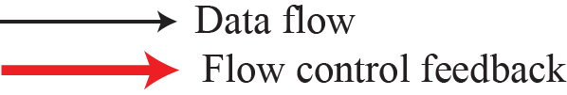
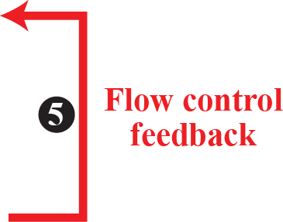
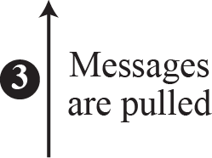
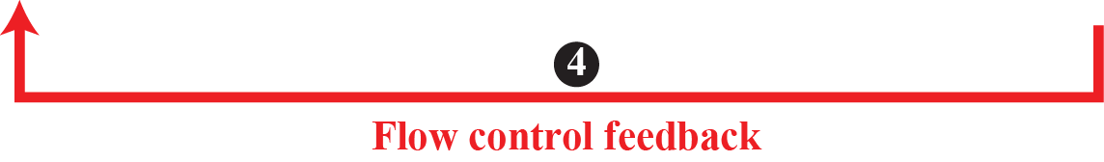
Figure 3.56: Data flow and flow control feedbacks in TCP

Slide 121
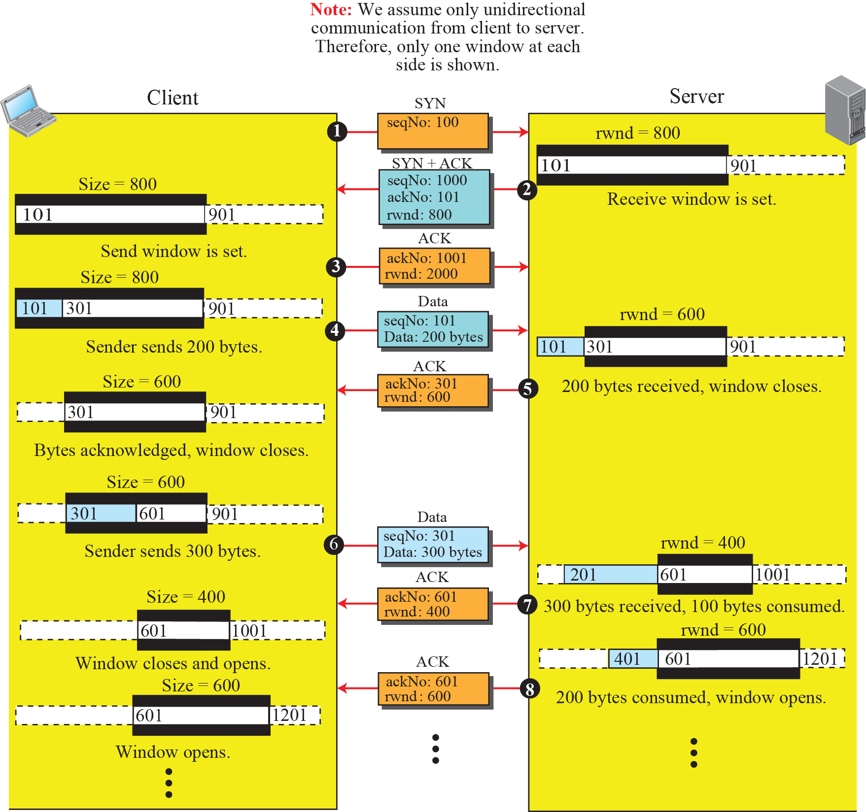
Figure 3.57: An example of flow control

Slide 122
Example 3.18
Figure 3.58 shows the reason for this mandate.
Part a of the figure shows the values of the last acknowledgment and rwnd. Part b shows the situation in which the sender has sent bytes 206 to 214. Bytes 206 to 209 are acknowledged and purged. The new advertisement, however, defines the new value of rwnd as 4, in which
210 + 4 < 206 + 12. When the send window shrinks, it creates a problem: byte 214, which has already been sent, is outside the window. The relation discussed before forces the receiver to maintain the right-hand wall of the window to be as shown in part a, because the receiver does not know which of the bytes 210 to 217 has already been sent. described above.

Slide 123
Figure 3.58: Example 3.18

Slide 124
3.4.8 Error Control
TCP is a reliable transport-layer protocol. This means that an application program that delivers a stream of data to TCP relies on TCP to deliver the entire stream to the application program on the other end in order, without error, and without any part lost or duplicated.

Slide 125
3.4.8 (continued)
Checksum
Acknowledgment
Cumulative Acknowledgment (ACK)
Selective Acknowledgment (SACK)
Generating Acknowledgments
Retransmission
Retransmission after RTO
Retransmission after Three Duplicate ACK
Out-of-Order Segments

Slide 126
3.4.8 (continued)
FSMs for Data Transfer in TCP
Sender-Side FSM
Receiver-Side FSM
Some Scenarios
Normal Operation
Lost Segment
Fast Retransmission
Delayed Segment
Duplicate Segment
Automatically Corrected Lost ACK
Correction by Resending a Segment
Deadlock Created by Lost Acknowledgment

Slide 127
Figure 3.61: Normal operation

Slide 128
Figure 3.62: Lost segment

Slide 129
Figure 3.63: Fast retransmission

Slide 130
Figure 3.64: Lost acknowledgment

Slide 131
Figure 3.65: Lost acknowledgment corrected by resending a segment

Slide 132
3.4.9 TCP Congestion Control
TCP uses different policies to handle the congestion in the network. We describe these policies in this section.
Congestion Window
Congestion Detection
Congestion Policies
Slow Start: Exponential Increase
Congestion Avoidance: Additive Increase

Slide 133
3.4.9 (continued)
Policy Transition
Taho TCP
Reno TCP
NewReno TCP
Additive Increase, Multiplicative Decrease
TCP Throughput

Slide 134
Figure 3.66: Slow start, exponential increase

Slide 135
Figure 3.67: Congestion avoidance, additive increase

Slide 136
Figure 3.68: FSM for Taho TCP

Slide 137
Example 3.19
Figure 3.69 shows an example of congestion control in a Taho TCP. TCP starts data transfer and sets the ssthresh variable to an ambitious value of 16 MSS. TCP begins at the slow-start (SS) state with the cwnd = 1. The congestion window grows exponentially, but a time-out occurs after the third RTT (before reaching the threshold). TCP assumes that there is congestion in the network. It immediately sets the new ssthresh = 4 MSS (half of the current cwnd, which is 8) and begins a new slow start (SA) state with cwnd = 1 MSS. The congestion grows exponentially until it reaches the newly set threshold. TCP now moves to the congestion avoidance (CA) state and the congestion window grows additively until it reaches cwnd = 12 MSS.

Slide 138
Example 3.19 (continued)
At this moment, three duplicate ACKs arrive, another indication of the congestion in the network. TCP again halves the value of ssthresh to 6 MSS and begins a new slow-start (SS) state. The exponential growth of the cwnd continues. After RTT 15, the size of cwnd is 4 MSS. After sending four segments and receiving only two ACKs, the size of the window reaches the ssthresh (6) and the TCP moves to the congestion avoidance state. The data transfer now continues in the congestion avoidance (CA) state until the connection is terminated after RTT 20.

Slide 139
Figure 3.69: Example of Taho TCP

Slide 140
Figure 3.70: FSM for Reno TCP

Slide 141
Example 3.20
Figure 3.71 shows the same situation as Figure 3.69, but in Reno TCP. The changes in the congestion window are the same until RTT 13 when three duplicate ACKs arrive. At this moment, Reno TCP drops the ssthresh to 6 MSS, but it sets the cwnd to a much higher value (ssthresh + 3 = 9 MSS) instead of 1 MSS. It now moves to the fast recovery state. We assume that two more duplicate ACKs arrive until RTT 15, where cwndgrows exponentially. In this moment, a new ACK (not duplicate) arrives that announces the receipt of the lost segment. It now moves to the congestion avoidance state, but first deflates the congestion window to 6 MSS as though ignoring the whole fast-recovery state and moving back to the previous track.

Slide 142
Figure 3.71: Example of a Reno TCP

Slide 143
Figure 3.72: Additive increase, multiplicative decrease (AIMD)

Slide 144
Example 3.21
If MSS = 10 KB (kilobytes) and RTT = 100 ms in Figure 3.72, we can calculate the throughput as shown below.

Slide 145
3.4.10 TCP Timers
To perform their operations smoothly, most TCP implementations use at least four timers.
Retransmission Timer
Round-Trip Time (RTT)
Karn’s Algorithm
Exponential Backoff
Persistence Timer
Keepalive Timer
TIME-WAIT Timer

Slide 146
Example 3.22
Let us give a hypothetical example. Figure 3.73 shows part of a connection. The figure shows the connection establishment and part of the data transfer phases.
1. When the SYN segment is sent, there is no value for RTTM, RTTS, or RTTD. The value of RTO is set to 6.00 seconds. The following shows the value of these variables at this moment:

Slide 147
Example 3.22 (continued)
2. When the SYN+ACK segment arrives, RTTM is measured and is equal to 1.5 seconds. The following shows the values of these variables:

Slide 148
Example 3.22 (continued)
3. When the first data segment is sent, a new RTT measurement starts. Note that the sender does not start an RTT measurement when it sends the ACK segment, because it does not consume a sequence number and there is no time-out. No RTT measurement starts for the second data segment because a measurement is already in progress.

Slide 149
Figure 3.73: Example 3.22

Slide 150
Example 3.23
Figure 3.74 is a continuation of the previous example. There is retransmission and Karn’s algorithm is applied. The first segment in the figure is sent, but lost. The RTO timer expires after 4.74 seconds. The segment is retransmitted and the timer is set to 9.48, twice the previous value of RTO. This time an ACK is received before the time-out. We wait until we send a new segment and receive the ACK for it before recalculating the RTO (Karn’s algorithm).

Slide 151
Figure 3.74: Example 3.23

Slide 152
3.4.11 Options
The TCP header can have up to 40 bytes of optional information. Options convey additional information to the destination or align other options. These option are included on the book website for further reference.

Slide 153
Chapter 3: Summary
The main duty of a transport-layer protocol is to provide process-to-process communication. To define the processes, we need port numbers. The client program defines itself with an ephemeral port number. The server defines itself with a well-known port number. To send a message from one process to another, the transport-layer protocol encapsulates and decapsulates messages. Flow control balances the exchange of data items between a producer and a consumer. A transport-layer protocol can provide two types of services: connectionless and connection-oriented. In a connectionless service, the sender sends packets to the receiver without any connection establishment. In a connection-oriented service, the client and the server first need to establish a connection between themselves.

Slide 154
Chapter 3: Summary (continued)
We have discussed several common transport-layer protocols in this chapter. The Stop-and-Wait protocol provides both flow and error control, but is inefficient. The Go-Back-N protocol is the more efficient version of the Stop-and-Wait protocol and takes advantage of pipelining. The Selective-Repeat protocol, a modification of the Go-Back-N protocol, is better suited to handle packet loss. All of these protocols can be implemented bidirectionally using piggybacking.
UDP is a transport protocol that creates a process-to-process communication. UDP is a (mostly) unreliable and connectionless protocol that requires little overhead and offers fast delivery. The UDP packet is called a user datagram.

Slide 155
Chapter 3: Summary (continued)
Transmission Control Protocol (TCP) is another transport-layer protocol in the TCP/IP protocol suite. TCP provides process-to-process, full-duplex, and connection-oriented service. The unit of data transfer between two devices using TCP software is called a segment. A TCP connection consists of three phases: connection establishment, data transfer, and connection termination. TCP software is normally implemented as a finite state machine (FSM).

